Slide 1
Report
May-2023 MP Inspection BFX – UA300
Date : 10-Aug-2023
Prepared by: Rachel Ruan

Slide 2
Issue Description
23-Jun, ALT customer complain [BFX-UA300] May – 2023 Mass production issue.
Overall inspection result => Conditional Pass (Waived)
Defect Total:
Critical
• Unstable operation (hang up / no boot) * 3pcs ( 27-Jul Fii received NG sample )
Major
• Side LED – R is different color * 1pcs
• Screw inside * 1pcs

Slide 3
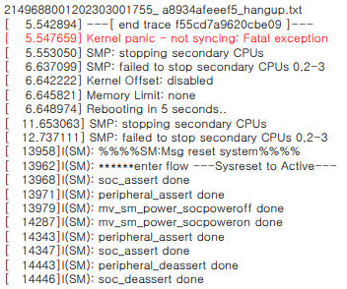
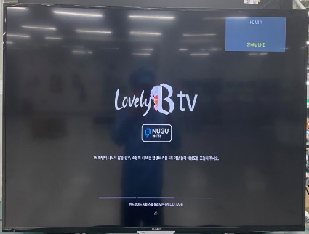
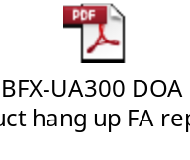
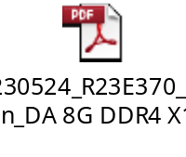
1. Unstable operation (hang up / no boot)
Issue Description | FA | Root cause | Actions | Status
Symptom: Unstable operation (hangup / no boot) Type: Critical Defect unit Q’ty : 3/315pcs Defect rate : 0.95% SKB SN: 2149695001202303001760, 2149695001202303001774, 2149695001202303001755 | As a Hang up log, kernel panic is occurring 1. Fii Check FATP data → Product test pass normally. 2. Fii Check error history in 2023/01/01 to 2023/07/29 : Fail symptom hang up and no boot is 4/12203 = 327 DPPM. 3. Check repair data history related to DDR component from 2023/01/01 to 2023/07/29, total production:12203pcs, fail q’ty: 4pcs, fail rate: 327 DPPM, not focus on any date code. | 1. Occur cause: This issue follow DDR4(P/N: 053.00502.005,D/C:2220,Vendor: SK HYNIX) material at U3 location. Note: DDR4 material only fail when it is in U3 location. 2. Escape cause: FATP can’t cover this issue. 3. 16-May-2023 Fii sent to HYNIX * 4 units IC U3 – Fail symptom hang up and no boot issue defect on production line. And 24-May-2023 Vendor sent 8D report confirm material is NDF issue. | 1. Verify new test program by NG sample (2023-08-08) which can cover this issue on FATP. Owner TE Jones. status: Done 2. Send 1pcs NG sample to RD support analysis find out root cause. Owner: PM An, RD Tom - FII co-work with RD and SK HYNIX vendor to improve this issue. Owner: RD Tom
Screen logo hang-up

Slide 4
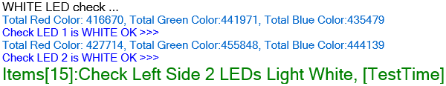
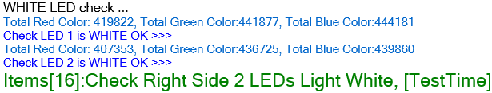
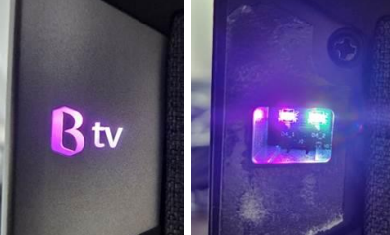
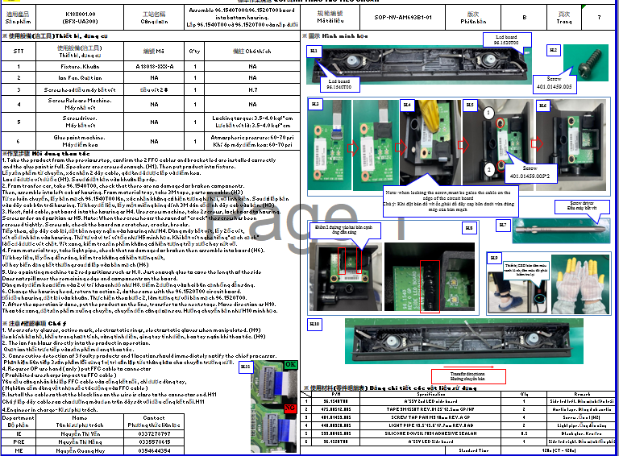
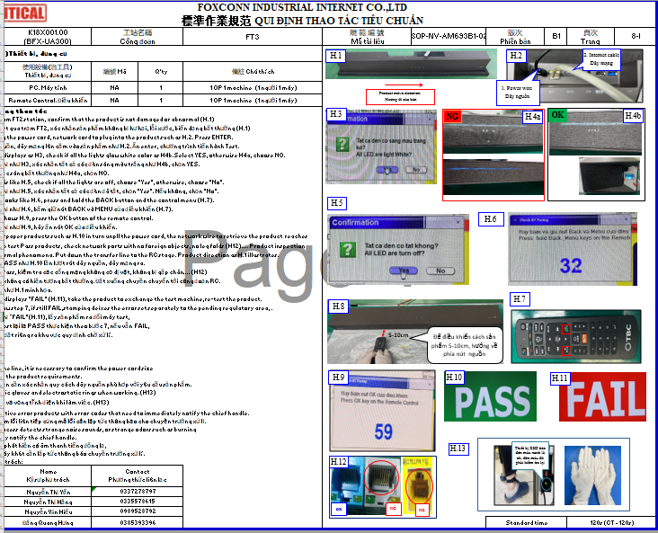
2. Side LED – R is different color
Issue Description | Root cause | Actions | Status
Symptom: Side LED – R is different color Type: Critical Defect unit Q’ty : 1/315pcs Defect rate : 0.31% SKB SN: 2149695001202303001179 | 1. Check FATP data SN ➔ Test recode had Fail R-FT2 cause fail speaker ( WAL580) no related LED issue. 2. Check test-Log of the station FT1 and FT3 ➔ PASS normal 3. The station FT1 ( Check LED by test program – machine ) and FT3 ( manual check by OP-eye ) have check LED light and LED color, But maybe due disassembly housing can make loose plug FFC cable. 4. Maybe OP operation due disassembly the cable hasn’t fully inserted. When we test function this unit FFC cable connect unstable make pass check LED function. | 1. Re-training OP doing and rework follow SOP define. Status : Done 2. Online verify 10 units had rework after disassembly housing, test FT1 and FT3 , check LED all is normal . Status : Done 3. OBA test function more product disassembly housing before packing. Status : Done

Slide 5
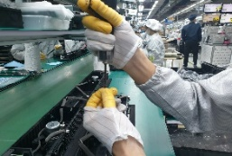
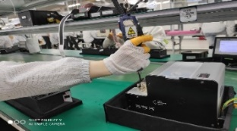
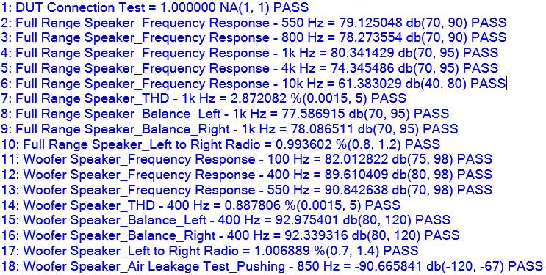
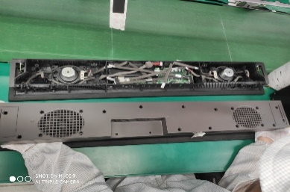
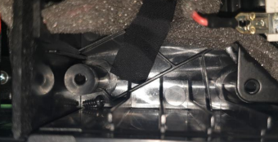
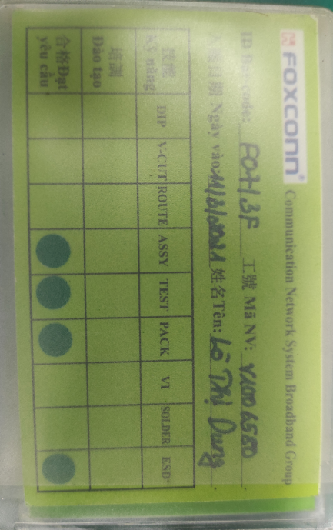
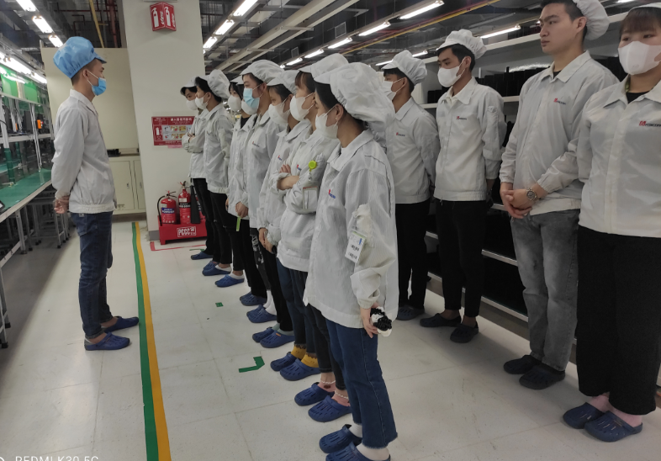
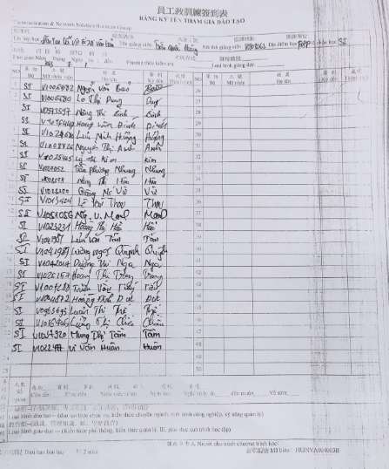
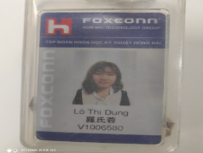
3. Screw inside
Issue Description | Root cause | Actions | Status
Symptom: Screw inside Type: Major Defect unit Q’ty : 1/315pcs Defect rate : 0.31% SKB SN: 2149695001202303002967 | 1. Check this units speaker test result: 18 items test speaker all PASS. 2. This station maybe OP use hand take screw out machine drop inside product, OP no upside down product before final Top case housing. ( SOP define it ) 2. V1006580 Lò Thị Dung. Line K2. | 1. Doing follow SOP ( SOP define take screw by machine, not by hand). Status : Done 2. Request each OP doing must have self check, re-check and final check. Status : Done 3. Before run line , line leader training OP, notice quality online issue, IPQC defect issue, OBA issue, read SOP and quality alarm. Status : Done
NG
OK

